Slide 1
Image Classification with CNNs
Luis Gilbuena

Slide 2
Problem Statement
Classifying images of fashion items
Can be used to tackle different classification problems
  More efficient
  Larger scale
  Reduces human error

Slide 3

Dataset
Fashion-MNIST
  10 categories
  70,000 images (10,000 test & 60,000 train)
  CSV file
Each row is a separate image
  Column 1 represents label
  784 columns that represent a singular pixel with values between 0-255
Preprocessing
  Turning 1-dimensional array into a 2-dimensional 28x28 array to represent our image
  Simplifying pixel values from 0-255 to 0-1
https://www.kaggle.com/datasets/zalando-research/fashionmnist?select=fashion-mnist_train.csv

Slide 4
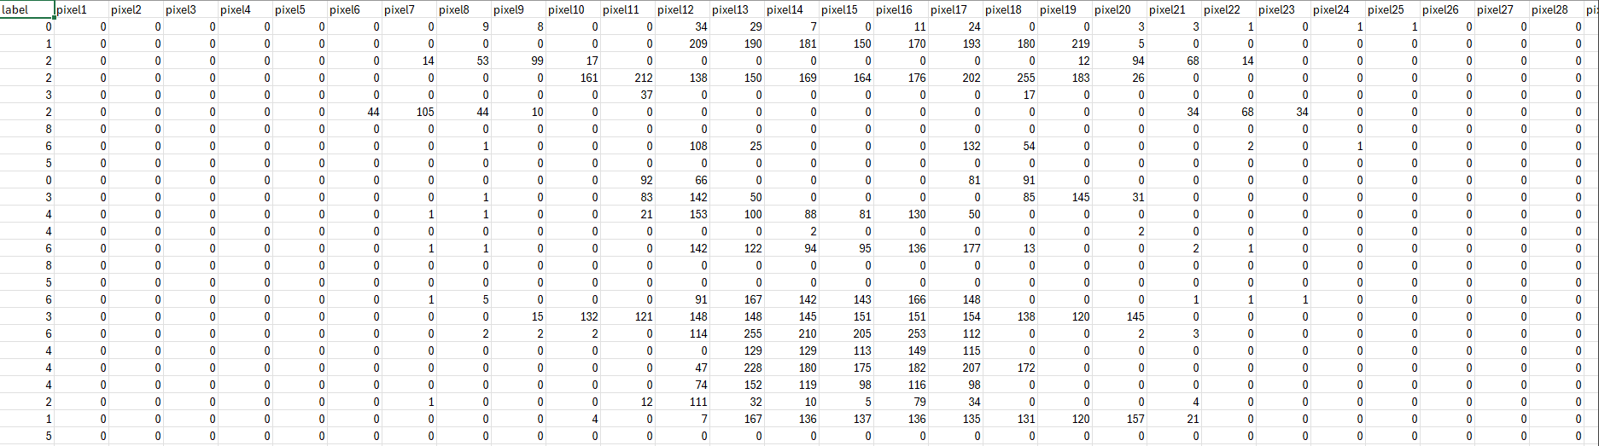
Dataset cont.

Slide 5
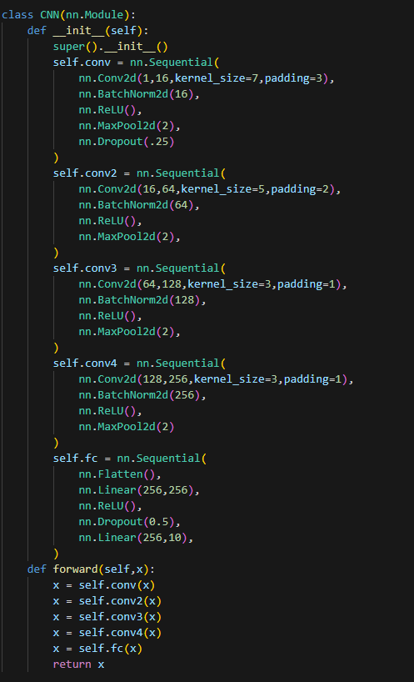

Implementation
Created a CNN to classify images (Pytorch)
  Tested different variants of hyperparameters
    Batch size
    Adjusting learning rate
    Dropoff
Current architecture
  4 convolutional layers -> fully connected
  Adam optimizer
  Cross Entropy Loss function

Slide 6
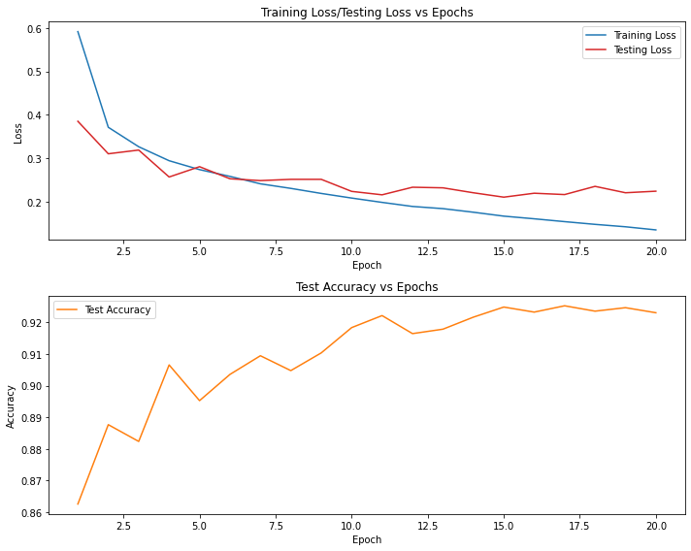
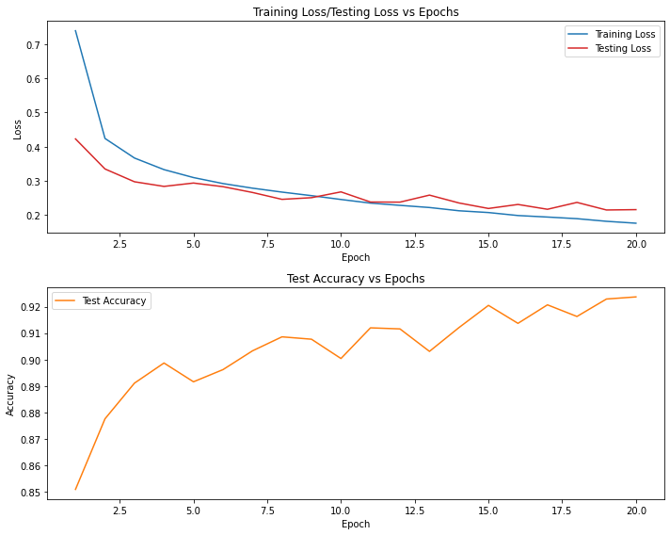
Batch count observations
Low batch
High batch

Slide 7
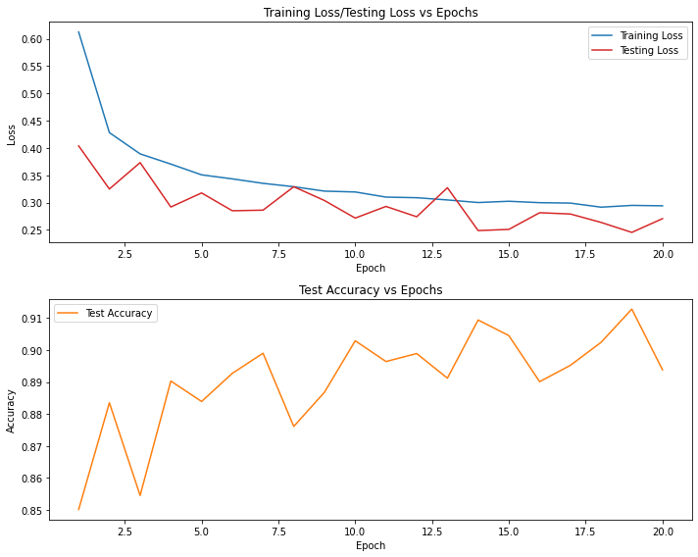
Learning rate observations
Low lr
High lr (50 min. runtime)

Slide 8
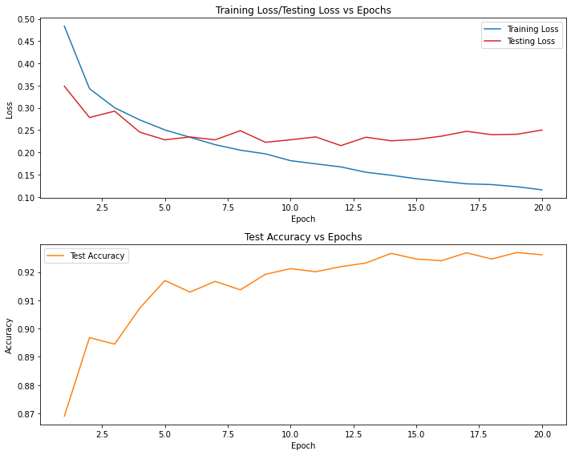
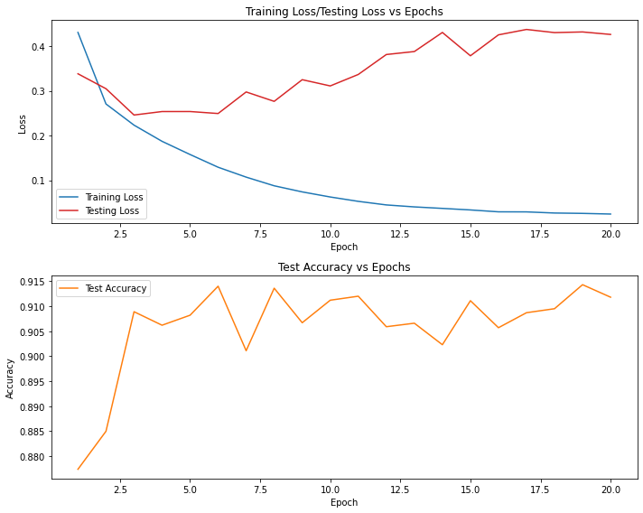
Dropout observations
With dropout
Without dropout

Slide 9
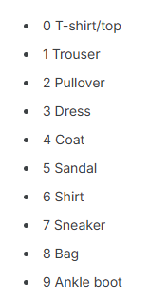
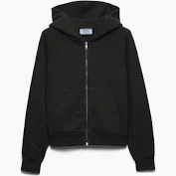
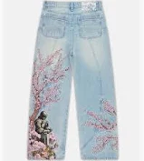
Future Work
Simple dataset
  Explore datasets that are more modern
    Lighting
    Background noise
    Fabric texture
    Higher resolution
Expand the classification to multi-label recognition
  Classify clothes as well as identify their attributes
    Fabric texture
    Color

Slide 10
Conclusion
Overall success
  Final accuracy consistently landed between 92%-93%
  Learned more about the effects of tuning hyperparameters
  Able to assess the strengths and weakness of this project
    Explore further improvements that could focused upon this project

